Slide 1
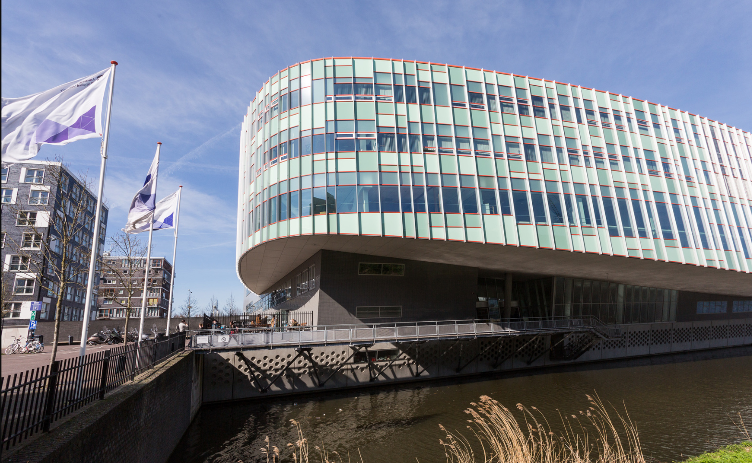
Welcome to Northumbria University Amsterdam Campus Induction
Your journey starts now.

Slide 2
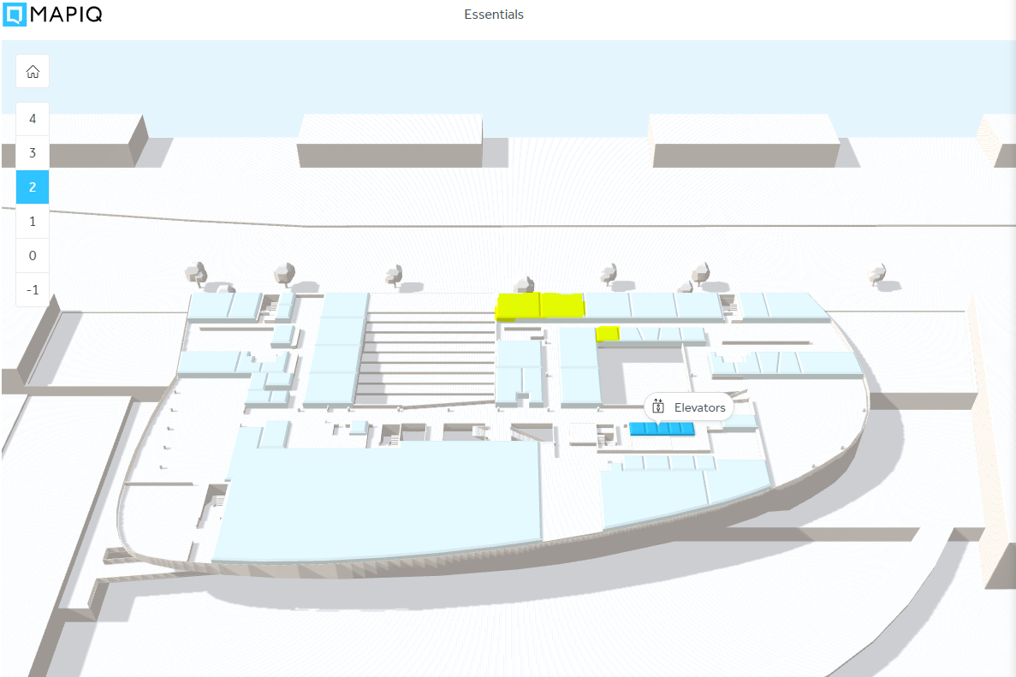
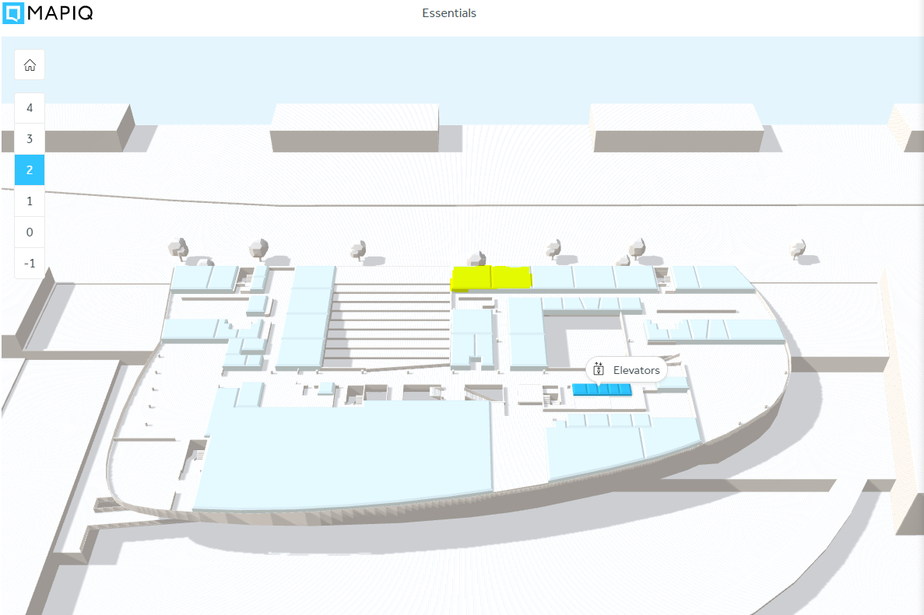
Welcome to your Amsterdam campus
Teaching rooms are located on the second floor of Corry Tendeloo building:
Room 2.020
Room 2.024
Your support team is very close to you in Room 2.028
Other facilities you may like to visit
The Library is on the ground floor
The restaurant on the 1st floor
The coffeeshop on the ground floor

Slide 3
Your induction module at Northumbria University Amsterdam
Congratulations you have enrolled and can now access your Virtual Learning Environment, Blackboard Ultra. Your next step is to complete your induction module.
Step 1: Login to Blackboard via the link on your Student Portal
Step 2: Review your programme handbook. It contains all the information you need about your master’s degree.
Step 3: Start your Amsterdam Campus Induction Course where you learn how to navigate your learning environment, the skills you will need to be successful and how to manage your studies.
Step 4: Check your knowledge by completing the quizzes
Note: While the course is not graded or mandatory it will provide you the knowledge and resources you need to become a successful student at Northumbria University.

Slide 4
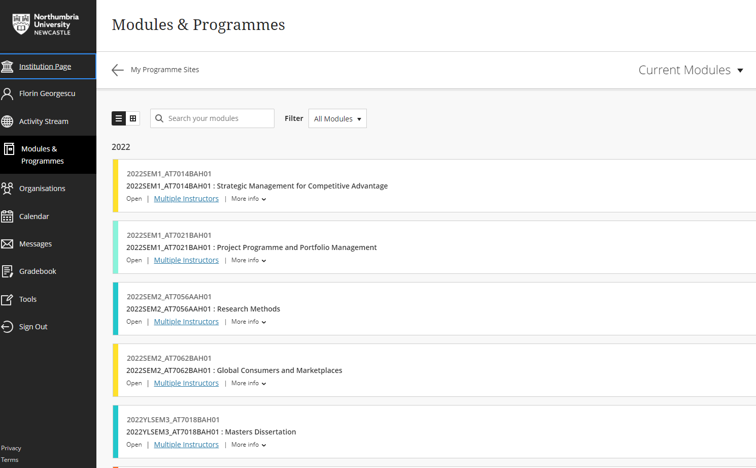
Accessing Amsterdam Campus Induction Course
Login to Blackboard.
Click on the Institution page
Click launch Management Suite
Click Add Organisation to your workload
Type AR072 and click Go and Submit

Slide 5
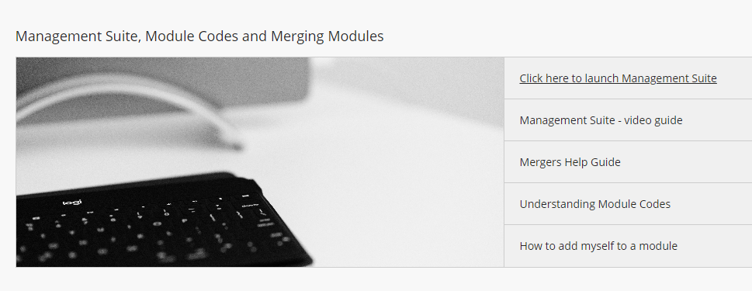
Accessing Amsterdam Campus Induction Course
Login to Blackboard.
Click on Institution page
Click launch Management Suite
Click Add Organisation to Workload
Type AR072 and click Go and Submit

Slide 6
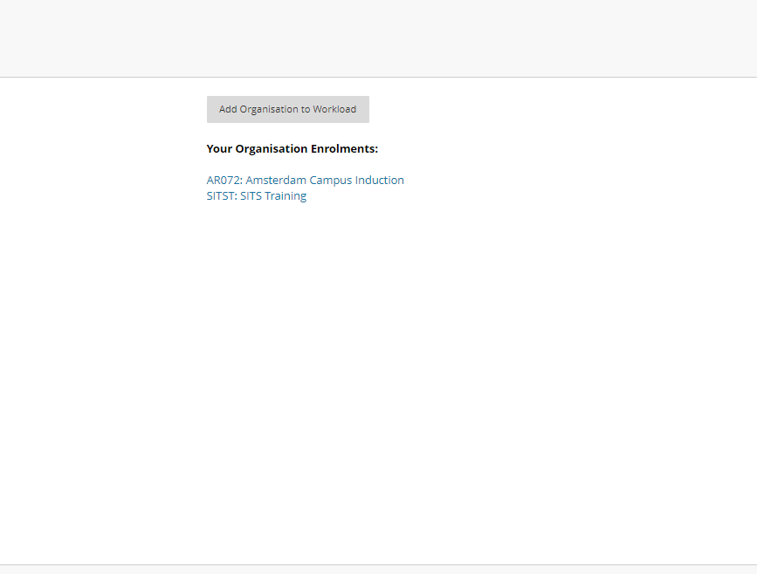
Accessing Amsterdam Campus Induction Course
Login to Blackboard.
Click on Institution page
Click launch Management Suite
Click Add Organisation to Workload
Type AR072 and click Go and Submit

Slide 7
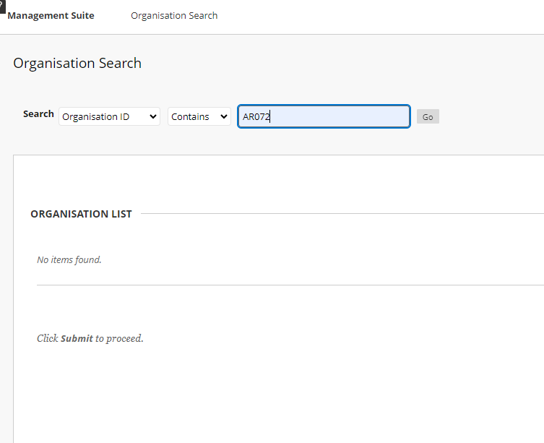
Accessing Amsterdam Campus Induction Course
Login to Blackboard.
Click on Institution page
Click launch Management Suite
Click Add Organisation to Workload
Type AR072 and click Go and Submit

