Slide 1
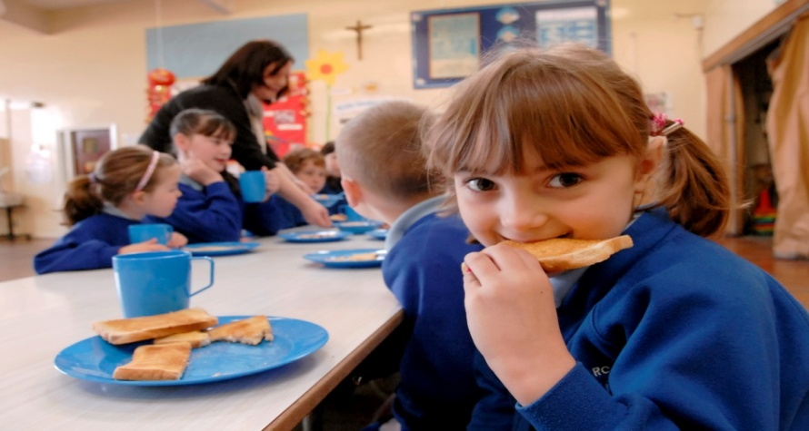
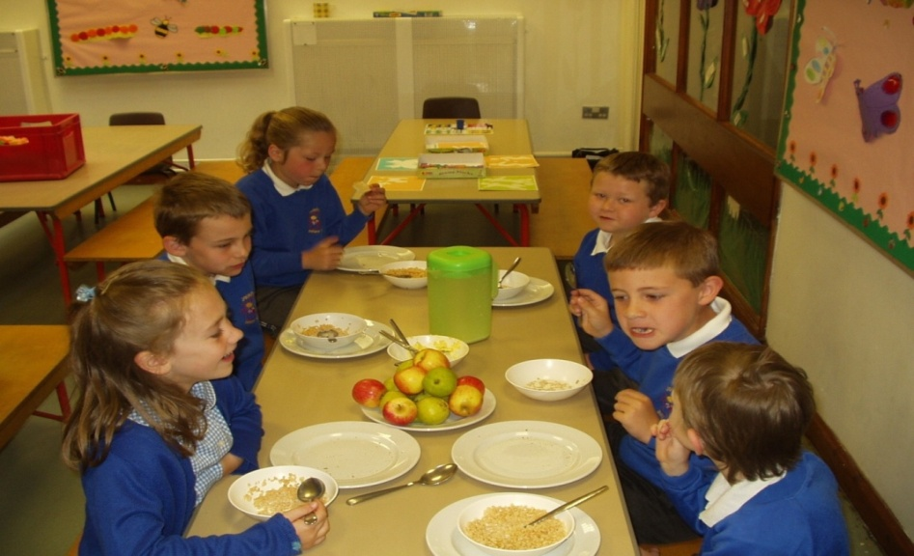
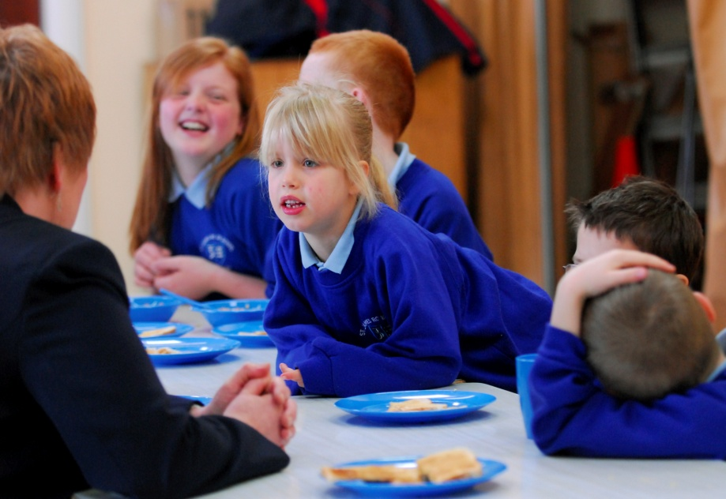
School Breakfast Clubs
, free resources for schools
Notes:
This Bitesize session is about the effects of Breakfast Clubs on Social Relationships and Behaviours.
It will focus on:
Benefits of Breakfast Clubs
More than just a meal – Additional Social Benefits
The facilitation of Peer Relationships
Effects of Skipping Breakfast and Food Insufficiency
Breakfast Clubs and Behaviour (Mixed scientific results)
A Case Study
Example Group Activities

Slide 2
Rules & Regulations (1)
Child Nutrition, Healthy Eating Practices & Breakfast Club Guidelines (3)
Educational/ Cognitive Performance (4)
Social Relationships & Behaviours (2)
Effective Planning, Funding & Financial Costs, Grant Writing, and Evaluation (5).
Notes:
So we have covered the foundations in relation to Rules and Regulations.
This session will focus on Social Relationships and Behaviours.

Slide 3
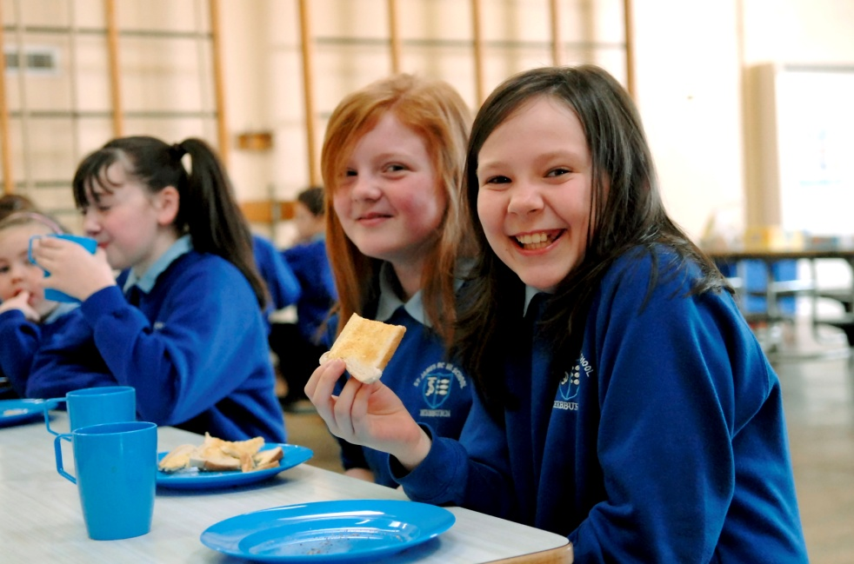
Social Relationships and Behaviours (2)
Evaluation
Research
Planning
Notes:
As in all of our sessions we will look at the role of translational research (i.e. academic research into policy and practice).

Slide 4
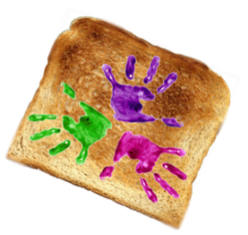
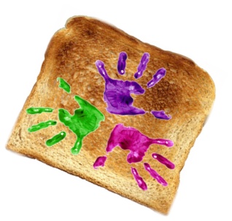
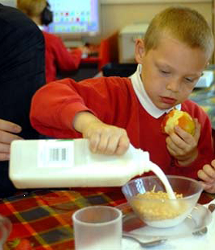
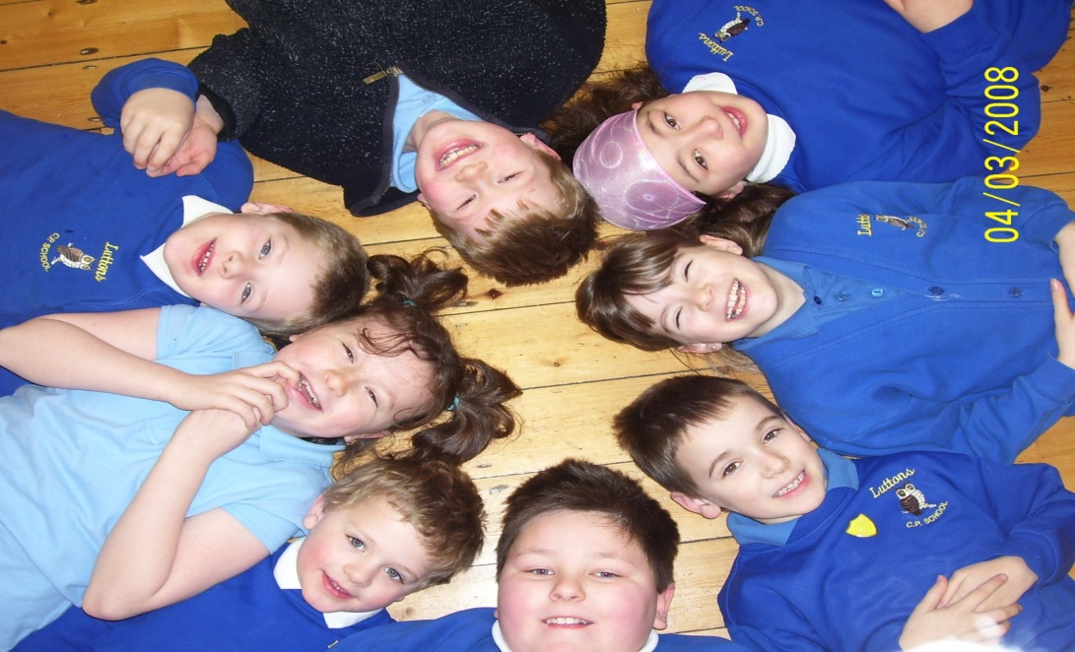
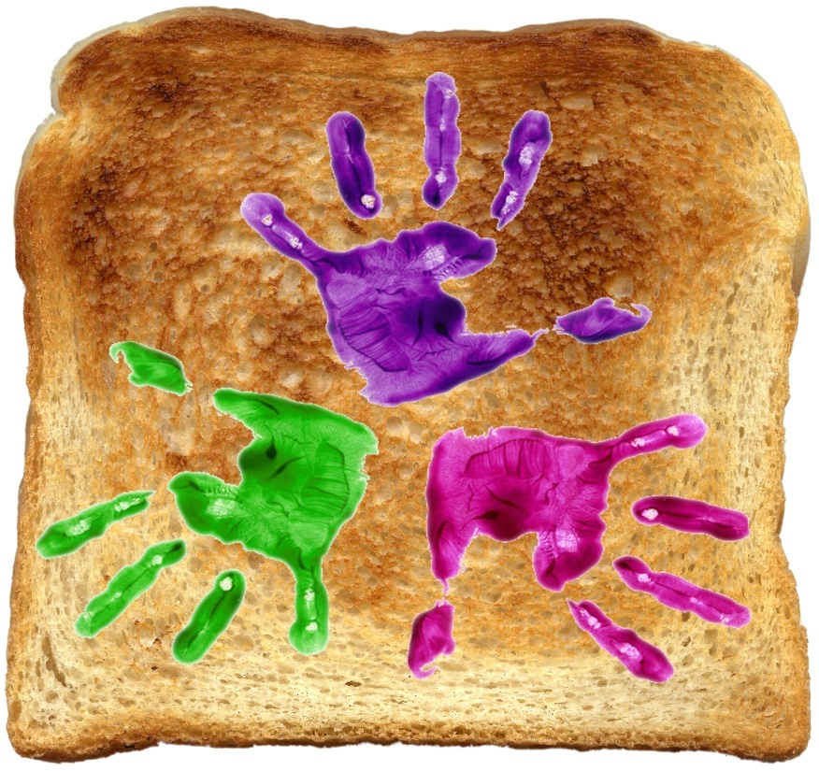
Benefits of Breakfast Clubs
School breakfast participation has been linked to many improvements including:
Development of social friendships
Classroom behaviour
The social environment is important
Notes:
Research into school Breakfast Clubs has linked participation to a range of benefits, including improved maths grades and school attendance and behaviour.
These will be discussed in the session on academic and cognitive performance.
In this session we will focus on how Breakfast Clubs facilitate social relationships and positive classroom behaviours.
.
We all know that not only must the food be enjoyable, but the setting must be pleasant too! In terms of bringing together food and childcare, equal attention needs to be placed on both parts. Healthy food in a chaotic environment will not result in good behaviour and improved educational outcomes. Likewise, poor quality food served in a good environment will not provide children with good dietary intake to support physical growth and cognition.

Slide 5
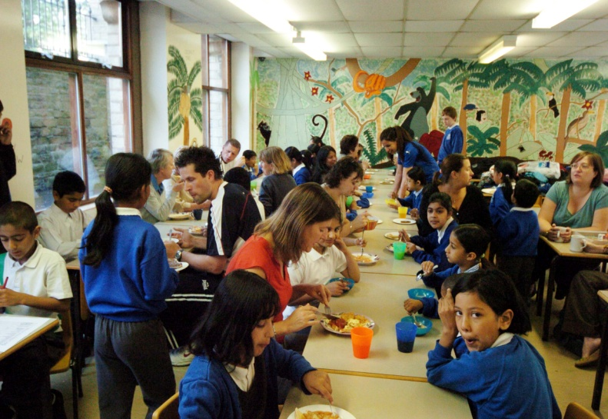
Benefits associated with school breakfast participation have been attributed mainly to the breakfast meal but the social environment including where it is and the activities provided are also important.
Notes:
So obviously the food has to be yummy but the environment needs to be inviting and interesting too.

Slide 6
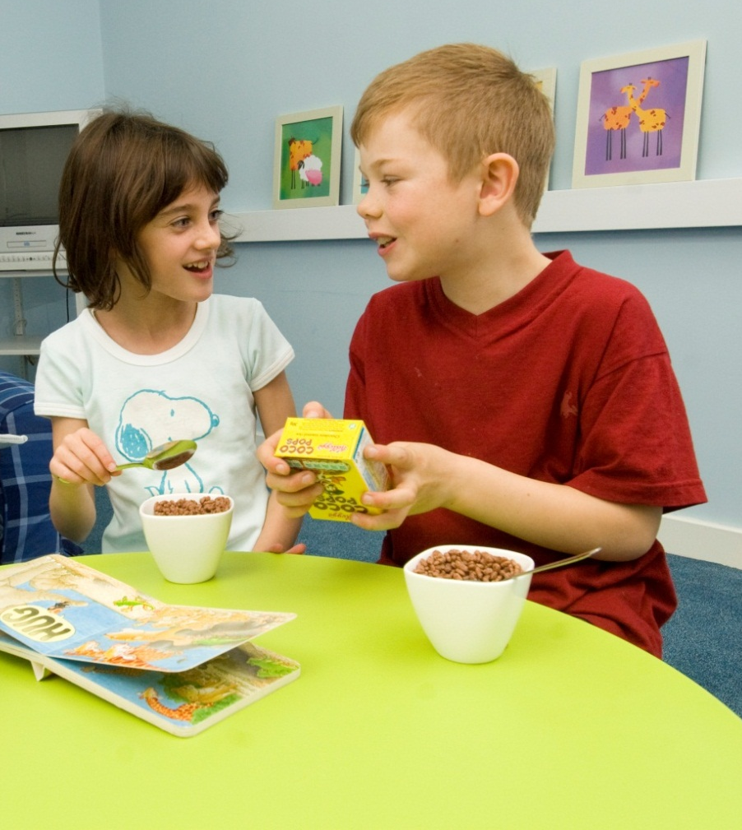
More than just a meal?
Family Mealtimes
Community & belonging
Facilitate interaction
Teach social skills
Notes:
So, why might Breakfast Clubs facilitate children’s friendships? We realise you are pushed for time so we have summarised the take home message. As you can see there are two areas of research that are relevant to this question.
Social relationships that develop while eating meals with others build a sense of community and belonging suggesting that the provision of Breakfast Clubs enhances children’s friendships by providing them with a sense of community.
Other researchers have also pointed out that family mealtimes facilitate interaction and offer an opportunity to teach children social skills, so for example, they create a communicative situation where children are likely to interact and socialise with each other.

Slide 7
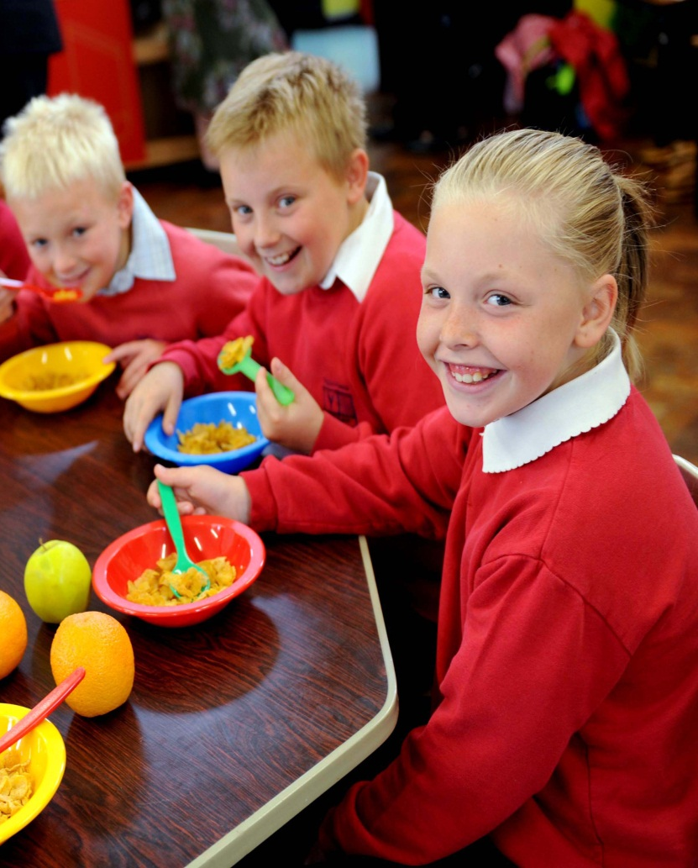
More than just a meal?
Extra Curricular Activities
Positive peer interaction
Development of friendship
Protection from victimisation
Childcare
Notes:
Another area of research has investigated the impact of participation in extra-curricular activities on children’s peer relationships.
Well organised activities can provide opportunities for positive peer interactions and the development of friendships.
Friendships are important as they have been found to act as a protective factor against victimisation.
If you take a moment to think about this, you do this all the time in everyday life whether you are a teacher, a teaching assistant, a volunteer...we all like to engage in social communication over a meal and most of us enjoy organised activities (whether it is Zumba class, book club, or going out for the night).
So, think about how this knowledge from our research findings and everyday life experience can help you to plan your Breakfast Club.

Slide 8
Researchers have found that children see Breakfast Clubs as an opportunity to meet their friends before class^{8,9}
“I like it because I just get to meet all me friends before I go to class.” (94%) (quote from a 9 year old from North East of England)

Slide 9
School Breakfast Club Attendance Facilitate Children’s Peer Relationships?
Researchers typically use scales to measure the social effects of Breakfast Clubs upon children and revealed some interesting findings.
Decrease in conflict between pupils, physical and social victimisation.
Increase in positive friendship features e.g. how close a child feels to their friends
Notes:
Researchers in our Healthy Living Lab conducted a study over a 6-month period looking at 3 groups of children:
Children attending a Breakfast Club
Children attending an after-school club
Children not attending any extra-curricular clubs
They measured the quality of children’s friendships & also levels of victimisation at two points: the beginning of the breakfast/ after-school clubs and then 6 months later to see if there had been any changes.
The results
In those children who attended a Breakfast Club, researchers found an increase in positive friendship features and a decrease in conflict among the children.
In those children who attended either a Breakfast Club or an after-school club, researchers found a reduction in physical and social victimisation.
So, we know that extra-curricular clubs help to provide children with a sense of belonging, facilitate relationships with staff and other pupils, and help teach important social skills, help children to establish and maintain friendships and often help with victimisation. It’s important to remember that Breakfast Clubs are more than just a place to eat breakfast (this needs to be considered in the later planning exercises).

Slide 10
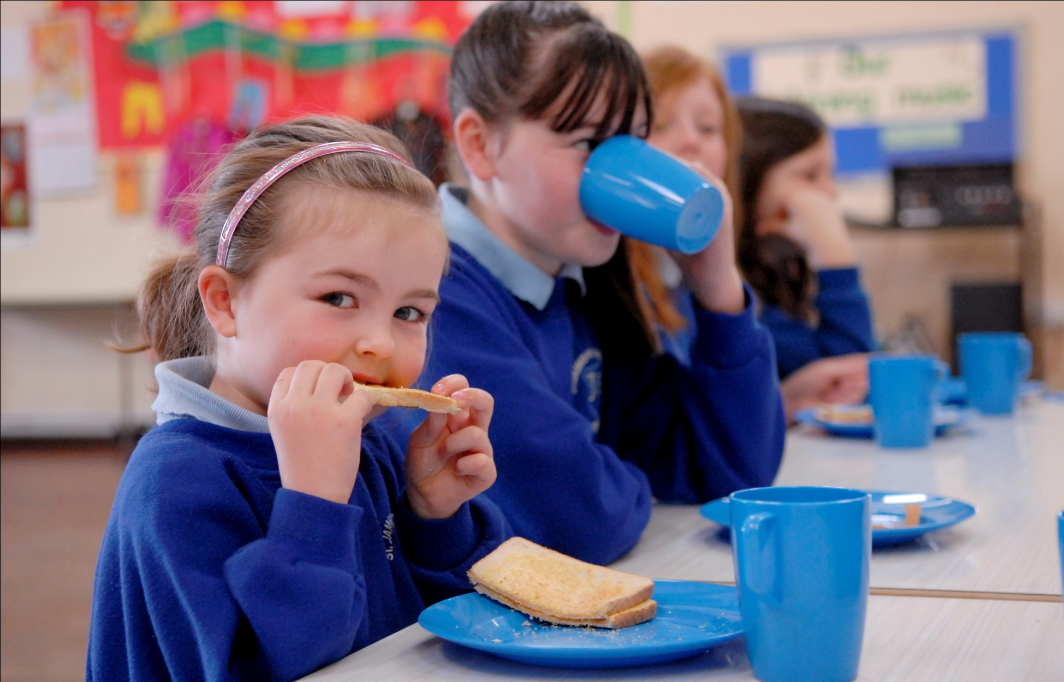
Breakfast Clubs & Children’s Behaviour
Notes:
Over the last decade more and more people have become concerned about the number of pupils arriving at school having skipped breakfast.
Research suggests that this may impact negatively on behaviour.

Slide 11
Food Insufficiency and Children’s Cognitive, Academic, and Psychosocial Development
Notes:
Think about how you feel if you are REALLY hungry. If you have had a fasting blood test: Did you feel cranky, spaced-out, suffered from headaches? Did you feel like being sociable and playing with others?
Research has shown that food insecurity (not having access to healthy food) is associated with a host of negative health, educational, social and economice outcomes.

Slide 12
Research has Shown
Living without enough food to eat meant that children and teenagers were more likely to experience difficulties……….
More than twice as likely to have seen a psychologist
Almost 3 times as likely to have been suspended
Almost twice as likely to have difficulty getting along with others
Four times as likely to experience complete social exclusion
Far more likely to experience psychosocial difficulties

Slide 13
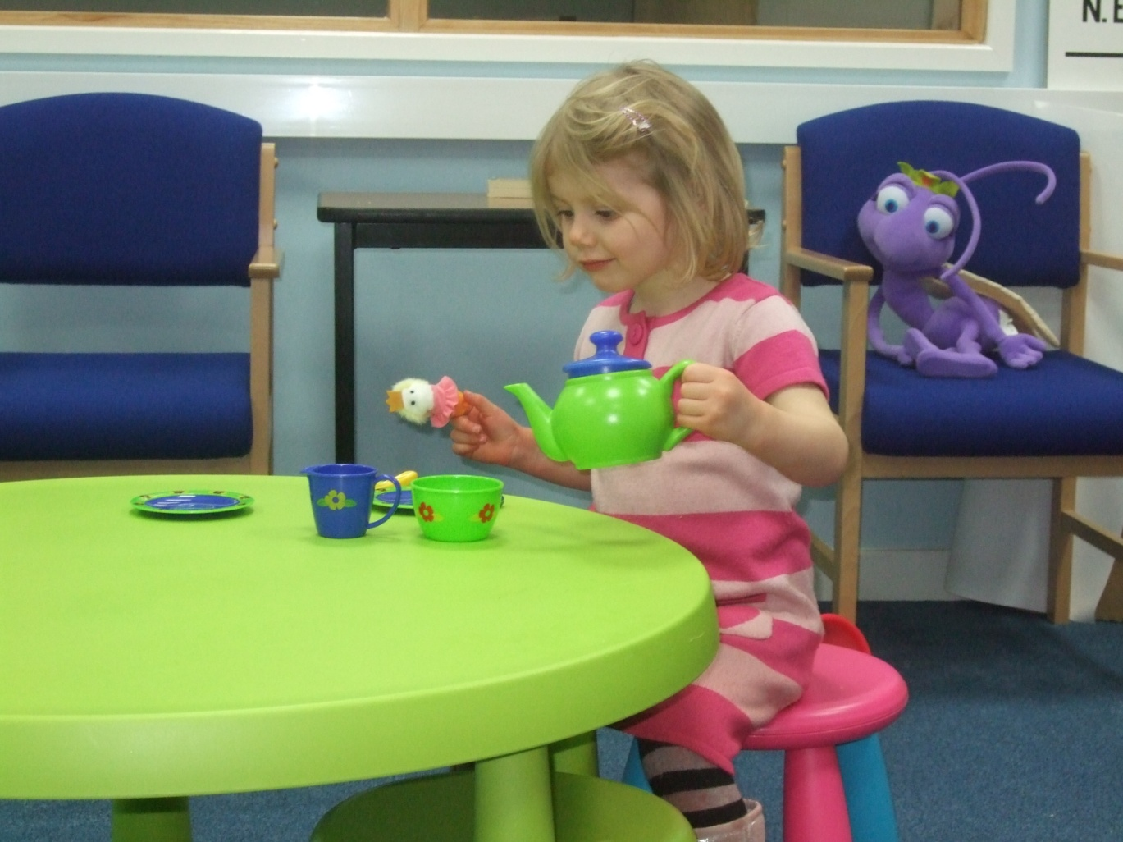
Breakfast Clubs and Children’s Behaviour

Slide 14
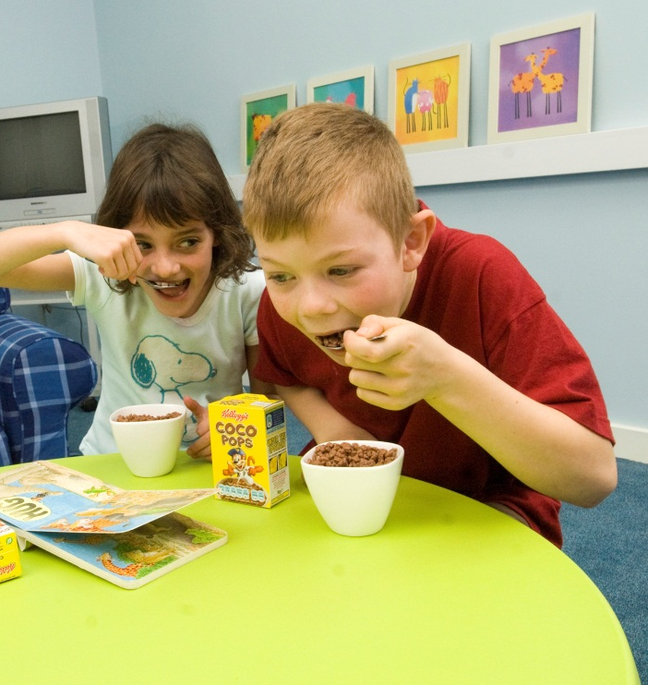
In terms of scientific research the effects of Breakfast Clubs on behaviour has produced mixed results……..
Some research reveals that skipping breakfast negatively impacts on children's classroom behaviour:
Hunger in Children in the United States: Potential Behavioural and Emotional Correlates.
Ronald E. Kleinman, J. Michael Murhpy, Michelle Little, Maria Pagano, Cheryl A. Wehler, Kenneth Regal and Michael S. Jellinek.
Paediatrics 1998; 101;e3.
The effects of an in-class breakfast program on on-task behavior of vocational high school students: A replication and analysis.
Bro, R. T., Shank, L. L., Williams, R. L., & McLaughlin, T. F. (1996).
Journal of Educational Research, 90, 111-115.
Notes:
As you can see there is a rather mixed pattern of findings.
The point here is that you have to consider your school’s breakfast club model, carefully plan, integrate into the wider school community etc (see planning session).

Slide 15
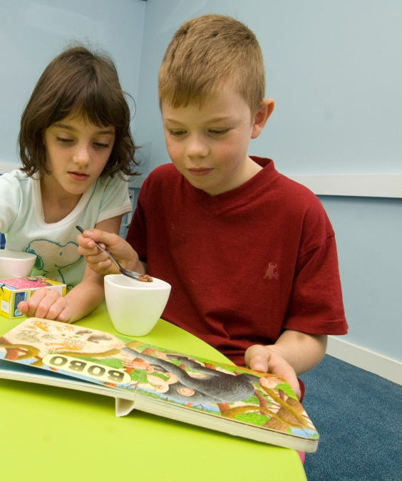
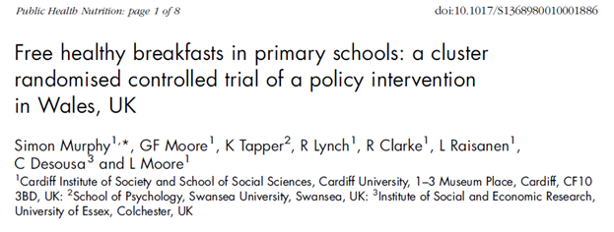
In terms of scientific research the effects of Breakfast Clubs on behaviour has produced mixed results……….
Whilst other research claims that Breakfast Clubs have no effect on children’s behaviour:

Slide 16
Positive Effect on Pupils’ Behaviour.
The influence of the glycaemic load of breakfast on the behaviour of children in school.
Benton, D., Maconie, A., Williams, C. (2007).
Physiol Behav, 92 (4), 717-24
Notes:
Three studies that show breakfast/Breakfast Club attendance has a positive effect on classroom behaviour. Overall, it is fair to say that in terms of empirical research the evidence is rather mixed.
However, many teachers really believe that Breakfast Clubs do have a positive effect on children’s behaviour. Again, choosing the ‘right’ model for your school with co-production with parents and children will increase the a) use and b) the impact of your breakfast club on a range of pupil and parent outcomes.

Slide 17
Group Activity:
Think about what activities you think are useful to incorporate in your Breakfast Club.
Reading activities?
Teeth brushing?
Notes:
Working in groups/discussing with colleagues/parents/pupils at your school or community venue (or on your own if you’re working alone online), draw up a table of activities that you would consider useful for your Breakfast Club. Think about other skills/activities you would like to incorporate in the future.
Remember you need to also consider activities that will engage YOUR children. There is no point in setting up activities if they will not attract children.
Top Tip: Start with one or two simple activities that fit with your overall objectives for starting a Breakfast Club.
Although your primary objectives may not be to teach children psychosocial skills, the majority of clubs that are successful are the clubs that children enjoy attending.
The correlation between attendance and friendships is strong. Research has shown that a good way to foster friendship is to engage children in psychosocial activities.
This is a great activity to conduct with parents and pupils.

Slide 18
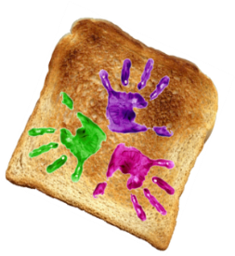
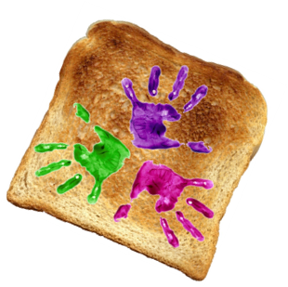
Breakfast Clubs can be a useful way to teach/develop essential concepts and skills.
For each of the following think about the activities that would work in your breakfast club and if you decide to incorporate an activity, think about how you would go about it
(i.e. Asking parents, implications, benefits, & limitations).
Hygiene Skills
Washing hands before breakfast
Brushing Teeth
Supporting peer interaction Activities
Structured games
Physical Skills
Supported learning/peer learning regarding the use of cutlery/crockery
Facilitating interaction with pupils of different age groups
Paired reading activities
Social interaction during breakfast
Parental involvement/family breakfast days
Cater for cultural need and diversity
Brushing teeth
Notes:
This is an example that you could use to plan activities for your Breakfast Club.
Remember what we covered earlier in the sessions, highlighting that the environment is really important as well as the food within a Breakfast Club so it’s a great way to get a head-start in planning some fun and educational things to do.

Slide 19
Example Activity Planning
Skill/ Activity
E.g. Teeth Brushing
Need assessed
E.g. Through parental questionnaire
Policy/ Regulations
E.g. Standards/ regulations will vary depending on location
Limitations
E.g. Accessibility to the cloakroom
Staff supervision
Benefits
E.g. Establishes good oral hygiene
Helps prevent decay & gum disease
Cost
DECISION
E.g. Minimal if child brings their own toothbrush
No action at this time
Reconsider at next review
Proceed with action
Notes:
This is anexample butto work. Think up an activity/skill (also ask some colleagues, parents and children). Construct a simple questionnaire (an example questionnaire is located on the eLearning Portal).
This will allow you to access the current need and save you a lot of time. Check any existing national/school policies. Consider what physical, cultural, time, staff etc. Limitations you have encountered. Can they be overcome? Consider the benefits to children.
This is only a fictitious example but provides you with some idea of the planning required. Remember “Rome was not built in a day”. Start off with activities that you are comfortable with and that children/parents want.

