Slide 1
Global Action for Climate Justice
Stephen Levett & Sara Boulton, York Law School, The University of York
Shaila Pal, Dickson Poon School of Law, King’s College London

Slide 2
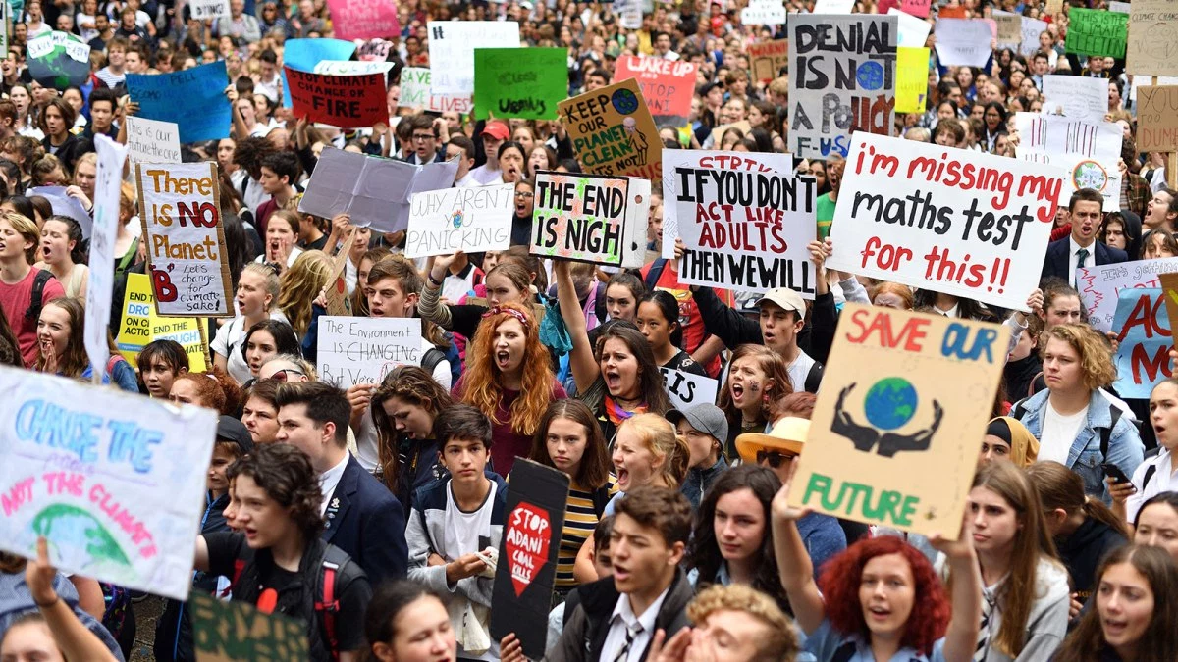

Slide 3
Climate change is one of the most significant social justice issues we face. Its impacts will be felt most by the poorest and most vulnerable. As a student law clinic with a commitment to social justice, we commit to raising awareness of the issue of climate change in our teaching, research and activism; and to finding ways to support law students to contribute to the struggle for climate justice.

Slide 4
Activities
Streetlaw
Mock trials
Speaker series/Institutional workshops
Student led debates/ moots
Notes:
Sara

Slide 5
Streetlaw
Engage with climate justice NGOs, academics and lawyers to develop common set of materials: King’s
Collaborative approach within local community: York

Slide 6
Street Law: What rights do I have?
Right to a healthy environment and a duty as citizens to protect the environment, Aarhus Convention.
Aarhus Convention guarantees 3 basic procedural rights:
The right to access information
The right to participate in the formulation of plans relating to the environment
The right to go to court to challenge breaches of environmental law

Slide 7
The Right to clean air, Air Quality Directive (EU)
State obligations
Monitor and assess air quality + meet objectives
Report to public and Commission
Individual rights
Right to breath clean air that meets EU standards
Right to information about air quality
Implement air quality plans containing measures to achieve objectives
If breach, right to demand air quality plan to ensure standards are met

Slide 8
Street Law
Impact of air pollution in the community
U.K, Air pollution responsible for more deaths than smoking
https://www.independent.co.uk/news/health/air-pollution-smoking-deaths-compare-a8818851.html
London: Ella Kissi-Debrah: new inquest granted into 'air pollution' death
https://www.theguardian.com/uk-news/2019/may/02/ella-kissi-debrah-new-inquest-granted-into-air-pollution-death
Action: Clean air pledge, supporting community action, lobbying MP, group court action(via NGO)

Slide 9
Activities
Streetlaw
Mock trials
Speaker series/Institutional workshops
Student led debates/ moots
Notes:
Sara

Slide 10
Next steps
Sign the pledge
Tell everyone you have signed the pledge
Join us in an international student law clinic day of action
Join the organising committee
Help with media
https://www.facebook.com/climate.pledge.1
Think globally. Act locally.

